Slide 1

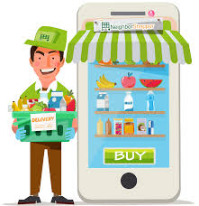
Grocery Management System
Under Guidance of:
Pooja Mehta
Submitted By:
1. Jayesh Thorve
2. Maroti Panchal
3. Krutika Khade
4. Nikhil Pelnekar
5. Niket Pawar
6. Prajkta Patil

Slide 2
INTRODUCTION
The Grocery Management System is developed to override the existing manual system.The purpose of this project is to automate the existing manual system with the help of computerized software by fulfilling all the requirements so that all the data can be stored at one place for long period of time with easy accessing and manipulating.
The main goal for developing this project where customer can purchase an order on groceries. The structure is very convenient for customer. They can easily buy the grocery products from home through internet. The system decrease a much of work load for customer.The system functionality of products an order is stored on the admin side in web service. Online grocery System is a method of E-Commerce that allows customer to buy a product form a seller over internet. There had been a increasing demand for e commerce sites, in the past decades. Online grocers, especially have growing in popularity.

Slide 3
PROJECT OBJECTIVE
The main objective of the project provides a lot of features to manage the product in well manner. This project contains managing the details of admin, product, orders,Customers,as well as payment.Basically the project describe how to manage for good performance and better services for customer.The project is totally built at administrative. The project is to build an application program for reduce the manual work for managing the customer,product and payments as per the requirements.

Slide 4
TECHNOLOGIES USED
Spring Boot
MySQL
Angular
Postman

Slide 5
REQUIRED SPECIFICATIONS
Hardware Configuration | Software Configuration
Operating System : Windows 10 and above | Software IDE: Eclipse, Postman, MySQL, VS Code.
Hard Disk: 500 GB | Language: JAVA, Type Script, HTML, CSS
RAM: 8 GB | Front End: Angular, Boot Strap
 | Back End: Spring Boot, MySQL.

Slide 6
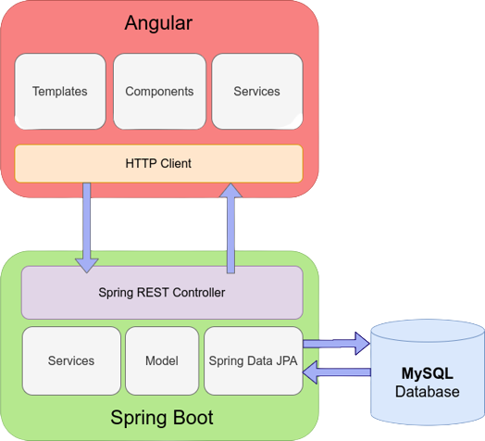
CONNECTION TO DATABASE FRONT END TO BACK END

Slide 7
MODULES
The system contains 6 Modules
ADMIN - Registration and Login.
CUSTOMER- Signup and Login.
PRODUCT LIST - Add/Edit Grocery items by Admin.
CART - Customer can add food from menu list
ORDER - It shows items which present in cart and order status.
PAYMENT – Customer has to pay for completion of order.

Slide 8
SPRING ANNOTATIONS
@Controller :The @Controller annotation indicates that a particular class serves the role of a controller. Spring Controller annotation is typically used in combination with annotated handler methods based on the @RequestMapping annotation.
@Autowired: The @Autowired annotation provides more fine-grained control over where and how autowiring should be accomplished.
@RequestMapping : The @RequestMapping is one of the most common annotation used in Spring Web applications. This annotation maps HTTP requests to handler methods of MVC and REST controllers.
@Entity: The @Entity annotation specifies that the class is an entity and is mapped to a database table.

Slide 9
SPRING ANNOTATIONS
@Table: The @Table annotation is used to create a table in database.
@JoinColumn: The @JoinColumn is used to specify a column for joining an entity association or element collection.
@PutMapping : The @PutMapping is used for update the records.
@PostMapping: The @PostMapping is used to create a resource Mapping.
@GetMapping: The @GetMapping is used to read all the inserted records.
@DeleteMapping : The @DeleteMapping is used to delete the records.
@PathVariable: The @Path Variable annotation is used to extract the value from the URL.
@RequestParam: The @RequestParam annotation is used to read the form data and bind it automatically to the parameter present in the provided method.

Slide 10
SPRING ANNOTATIONS
@Request Body: The @RequestBody annotation is applicable to handler methods of spring controller. spring should deserialize a request body into an object.
@OneToOne Mapping: The @OneToOne JPA annotation is used to map the source entity with the target entity, Hibernate maps the tables in your database to the Entity classes in your application.
@OneToMany Mapping: The @OneTo-Many relationship between table A and table B indicates that one row in a table A link to many rows in table B.but one row in table B links to only one row in table A.
@ManyToOne Mapping: The @Many-to-One mapping means that many instances of this entity are mapped to one instance of another entity.

Slide 11
SPRING ANNOTATIONS
@ExceptionHandler:The @ExceptionHandler is an annotation used to handle the specific exceptions and sending the custom responses to the client.
@ControllerAdvice: A controller advice allows you to use exactly the same exception handling techniques but apply them across the whole application, not just to an individual controller. You can think of them as an annotation driven interceptor.

Slide 12
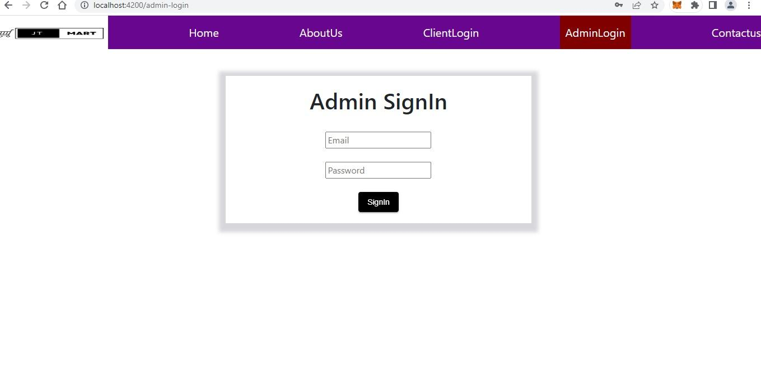
ADMIN LOGIN

Slide 13
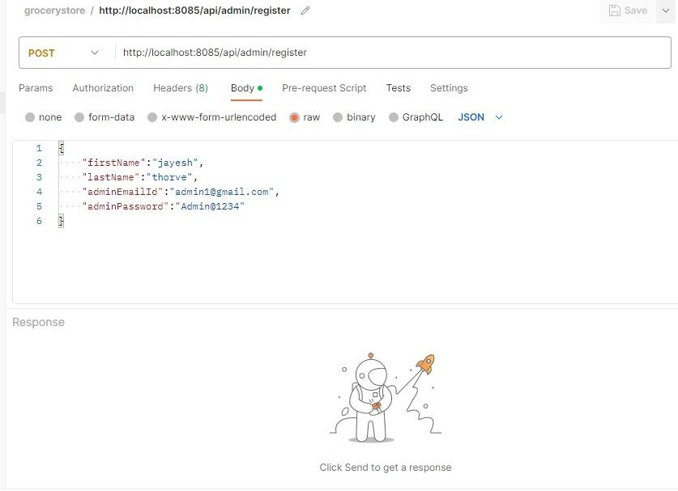
ADMIN DATA ENTRY IN MYSQL THROUGH POSTMAN

Slide 14
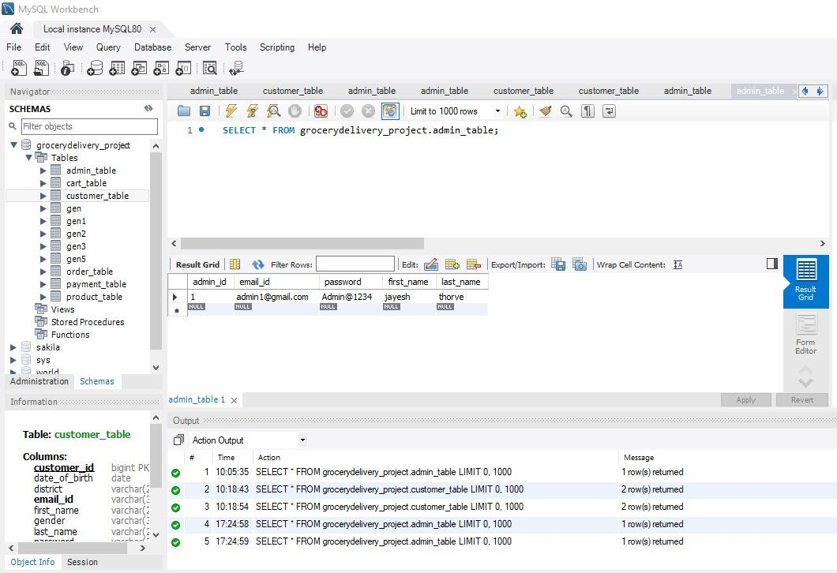
ADMIN TABLE

Slide 15
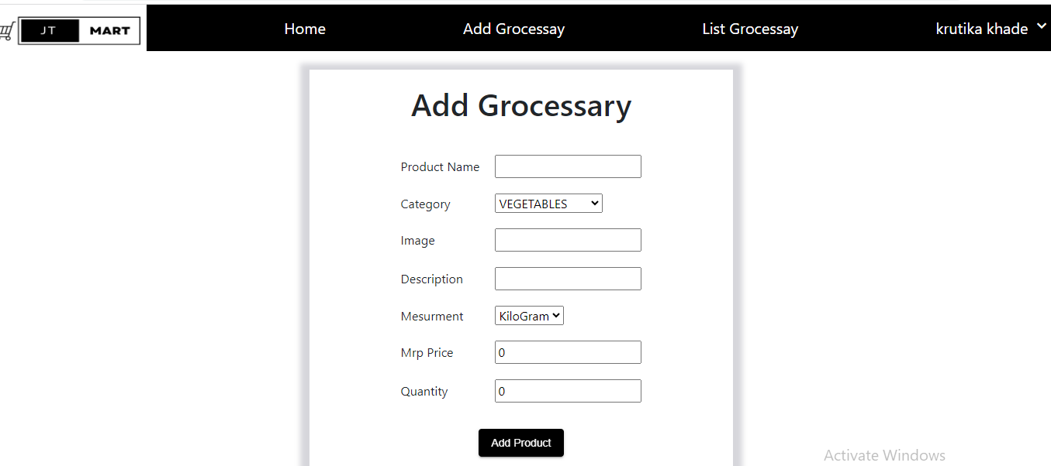
ADD PRODUCT

Slide 16
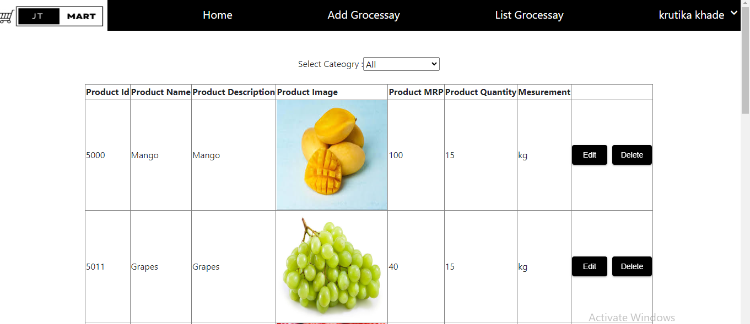
PRODUCT LIST

Slide 17
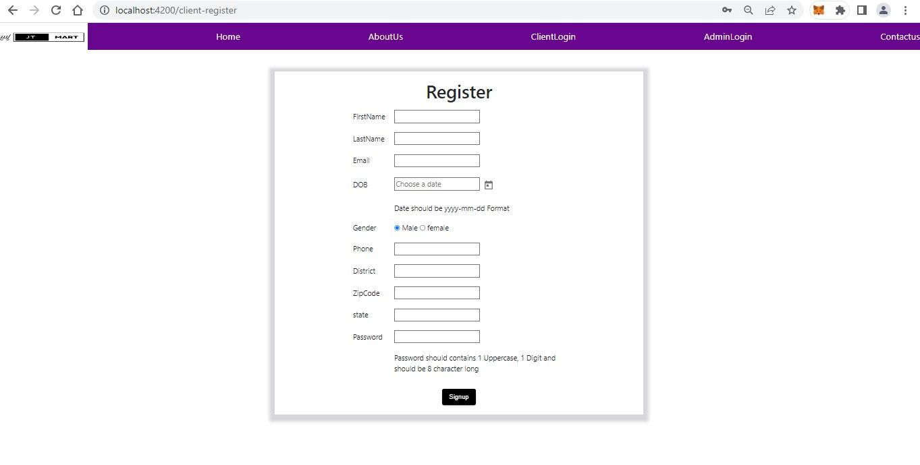
CUSTOMER REGISTRATION

Slide 18
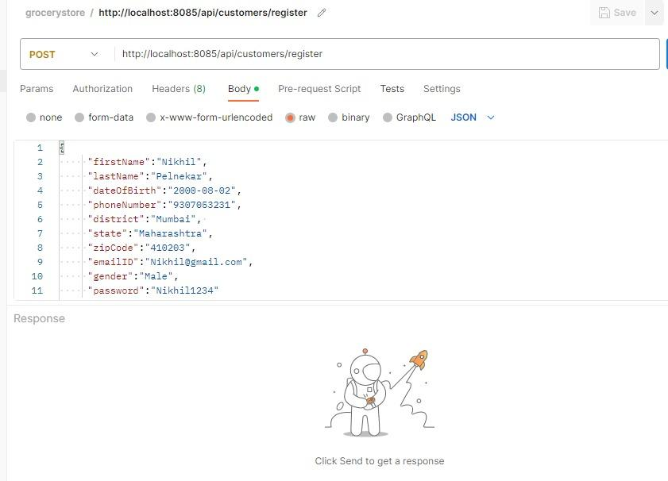
CUSTOMER DATA ENTRY IN MYSQL THROUGH POSTMAN

Slide 19
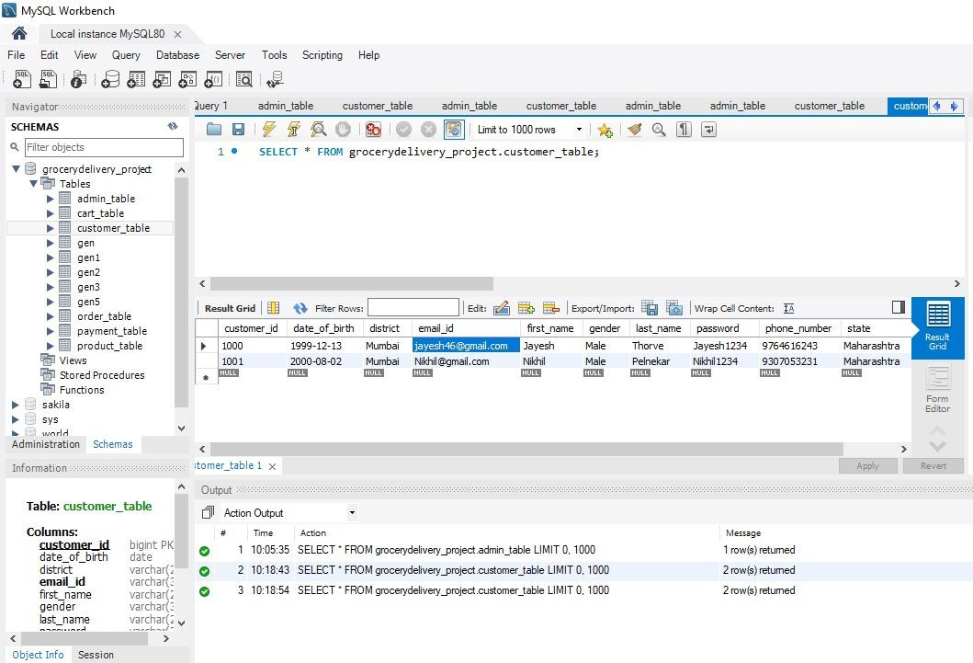
CUSTOMER TABLE

Slide 20
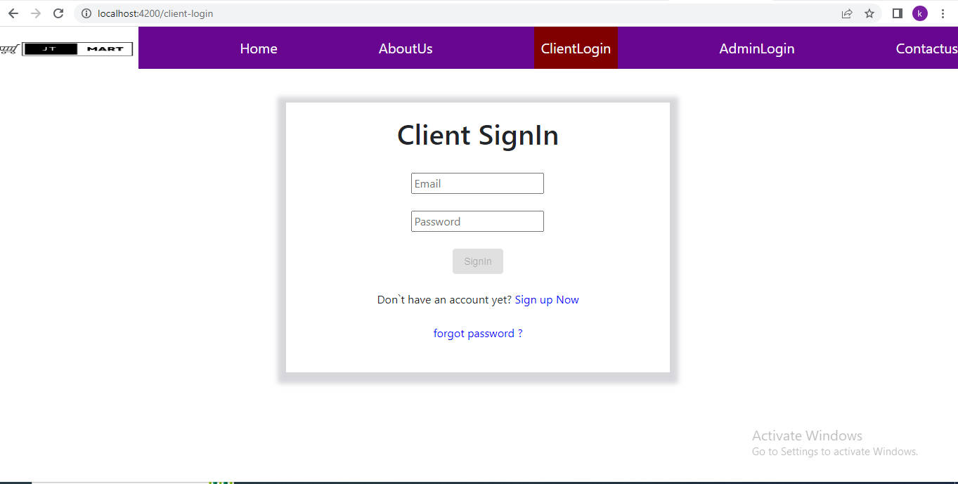
CUSTOMER LOGIN

Slide 21
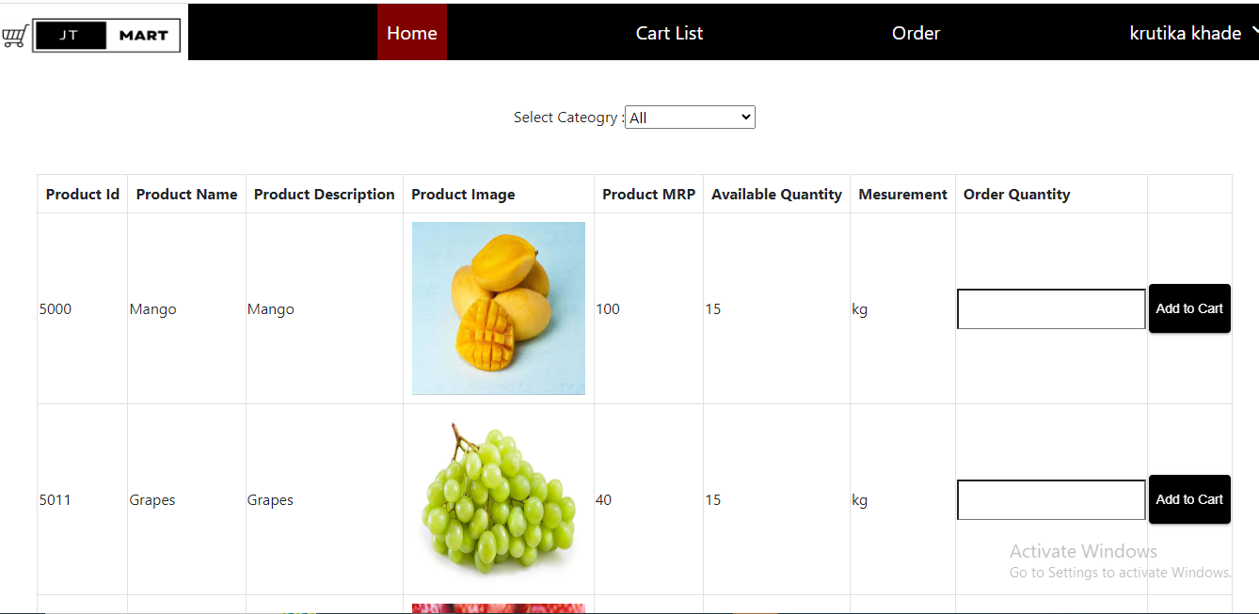
CUSTOMER HOME PAGE

Slide 22
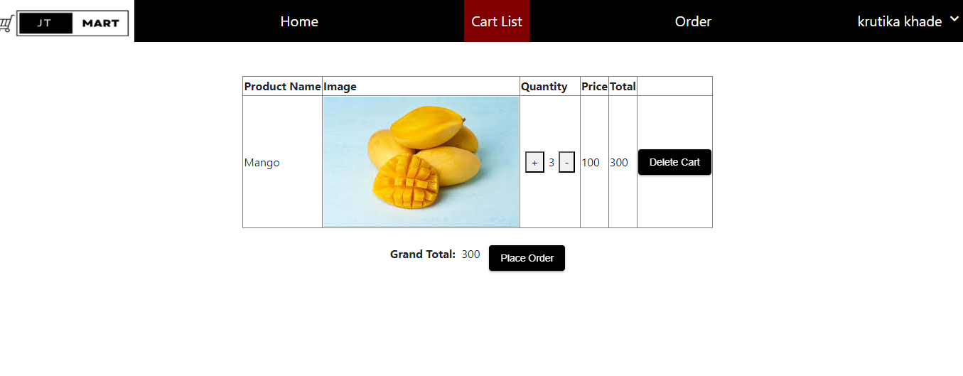
CUSTOMER CART

Slide 23
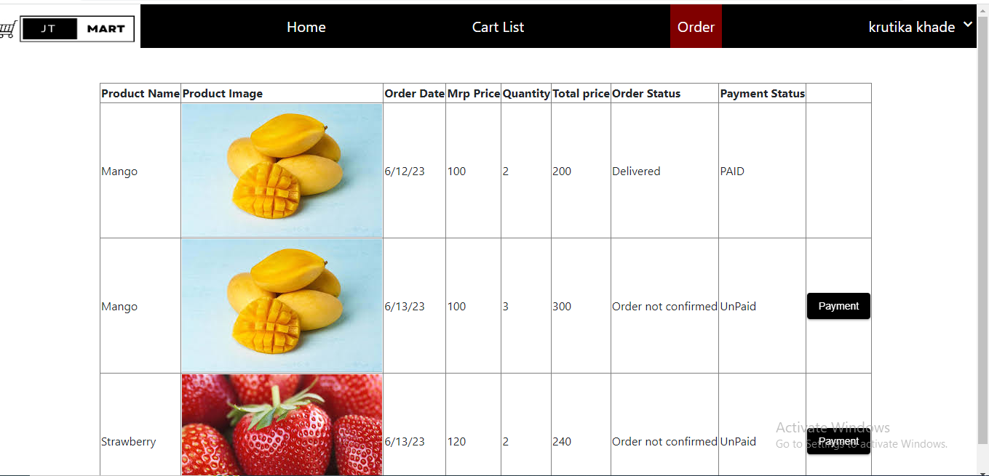
CUSTOMER ORDER

Slide 24
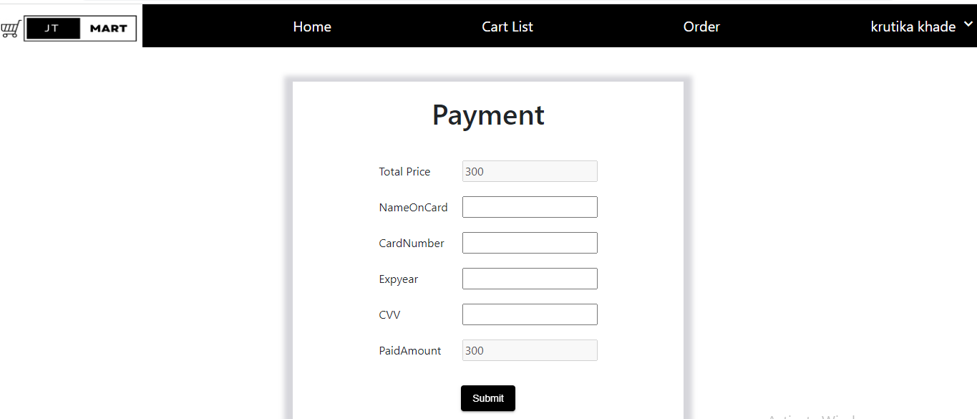
CUSTOMER PAYMENT

Slide 25
ADVANTAGES
Customer can Shop Grocery anytime.
Makes the ordering process easier.
Customer's satisfaction.
No need to visit the store.
Discover New Items.

Slide 26
CONCLUSION
Hence, we made the website of Grocery Management System
which provides more accessibility to admin and simple, attractive interface to user. Customers can get the Grocery by online which concludes safe delivery of product and customers can get the Grocery whenever it needed.

Slide 27
THANK YOU

